Slide 1

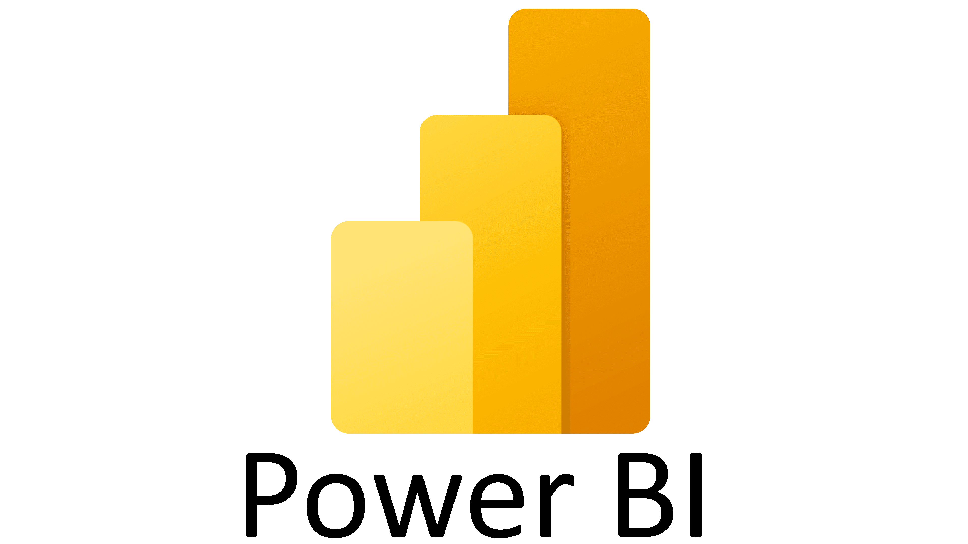
Intro to Semantic Models

Slide 2
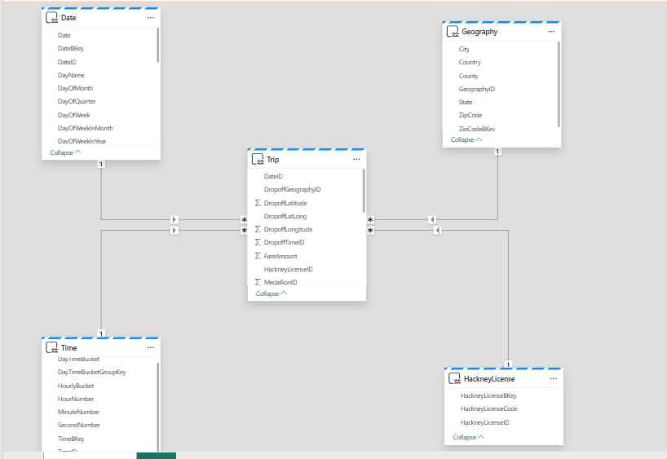
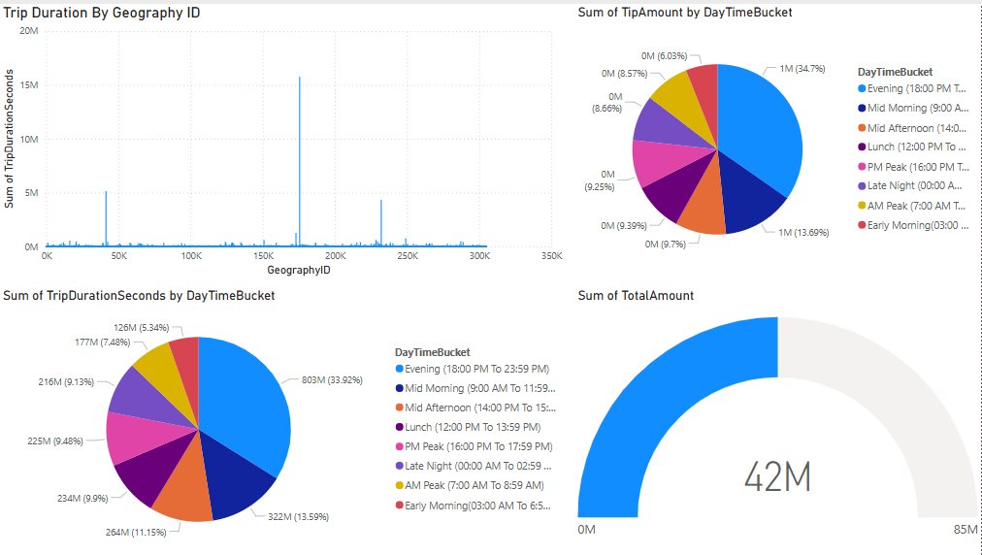
In Microsoft Fabric, Power BI semantic models are a logical description of an analytical domain, with metrics, business friendly terminology, and representation, to enable deeper analysis.
With the semantic model, the semantic model is created automatically for you, and you choose which tables, relationships, and measures are to be added, and the business logic gets inherited from the parent lakehouse or Warehouse respectively

Slide 3




Facts and Dimensions Tables in Semantic Models
Fact Tables:
Contain quantitative data (e.g., sales, revenue, or transaction details).
Represent the core measurements or metrics to be analyzed.
Dimension Tables:
Contain descriptive attributes or metadata (e.g., product names, customer details, or time periods).
Help provide context for the measures in fact tables.
Dimension tables are connected to fact tables via foreign key-primary key relationships, forming a star schema or snowflake schema.

Slide 4
Microsoft Fabric and Unified Semantic Models
Microsoft Fabric enhances Power BI’s capabilities by integrating data engineering, data lakes, and advanced analytics into a unified ecosystem.
Relationship with Fact and Dimension Tables:
Fact and dimension tables are stored and processed within OneLake, Fabric’s centralized data lake.
They can be directly used in Fabric Lakehouses or Warehouse for scalable modeling.
Semantic Models in Microsoft Fabric:
Leverage Direct Lake mode to directly query data in OneLake without moving it.
Enhanced scalability and performance for large datasets.
Unified data modeling with Power BI datasets, Fabric Warehouse, and Lakehouses.
Fact and dimension tables in Fabric pipelines feed into these semantic models.

